Slide 1
SIMPLIFICATION OF NUMERICAL EXPRESSIONS
(STD – V)

Slide 2
SUB TOPICS
BODMAS Rule
Different Brackets
Simplification of Whole numbers
Simplification of Decimal Numbers
Simplification Of Fractional Numbers
Brain Teasers
Value based Questions
Activities
Worksheets

Slide 3
LEARNING OBJECTIVES
Understand the BODMAS rule.
Know the different types of brackets.
Apply the rule in solving problems.
Evaluate numerical expressions invoving
* Whole Numbers
* Fractional Numbers
* Decimal Numbers

Slide 4
PREVIOUS KNOWLEDGE
Students already have the knowledge of
Different mathematical operations
Concept of Whole Numbers, Decimal Numbers and Fractional Numbers
Doing different mathematical Operations using Whole numbers, Decimal numbers and Fractional numbers.
Concept of “of” in mathematical language.

Slide 5
PREVIOUS KNOWLEDGE TESTING :-
What is the value of the following statements ?
- * 2+5
- * 16 ÷ 3
- * 9 x 7
- * 45 – 9
- * ½ + 1/3
- * 7/6 - 1/3
- * 7.2 ÷ 9
- * 15 % of 150

Slide 6
INTRODUCTION :-
“ I believe that a simple manner of life is best for everyone. Best both for the body and the mind.”
- Albert Einstein
Simplicity is the key to success. The simpler we can make the things, the better we can understand.
In Mathematics, we need to simplify some complex things in order to get the solution easily in an effective and efficient manner.

Slide 7
MEANING OF THE TERMS :-
SIMPLIFICATION – The process of making something simpler or easier to do or to understand. It is a process of dividing a complex task into relatively simpler tasks for easy calculation.
NUMERICAL – It is related to or expressed as a number or numbers.
NUMERICAL EXPRESSION – It is a mathematical phrase involving numbers and one or more operational symbols ( + , - , x , ÷ , .. etc).
For example – 4 + 5 ; 76 – 4 + 6 ; 56.4 x 6 etc

Slide 8
DMAS RULE :-

Slide 9
BODMAS RULE :-

Slide 10
BRACKETS :-

Slide 11
Sequence Of Solving Brackets :-
Line Brackets – To do First
Round Brackets – To do after Line Brackets
Curly Brackets – To do after Round Brackets
Square Brackets – To do after Curly Brackets

Slide 12
Look at the following example:

Slide 13
ACTIVITY 1 :-
https://www.youtube.com/watch?v=5fde2o6lMl8
The above activity can be done inside or outside of the class.
Different students will be given different numbers and and oparational symbols.
Following the BODMAS rule, they will arrange themselves and operations will be done accordingly.
Step by step, the answers will be shown.
It is an effective activity for understanding the concept of BODMAS in simplification.

Slide 14
* Solve the following:
[12 + {7 - (8 ÷ 2)}] × 3
= [12 + {7 - 4}] × 3 (Round brackets removed)
= [12 + 3] × 3 (Curly brackets removed)
= 15 × 3 (Square brackets removed)
= 45
14 + [22 - {8 + (6 ÷ 2)}]
= 14 + [22 - {8 + 3}] (Round brackets removed)
= 14 + [22 - 11] (Curly brackets removed)
= 14 + 11 (Square brackets removed)
= 25

Slide 15
SIMPLIFICATION INVOLVING WHOLE NUMBERS :-
Whole Numbers - Counting numbers are whole numbers.
Example of whole number : 0, 1 , 2 , 3 , 4 , ......... Etc
The simplification of whole number involve the same BODMAS rule while simplifying the expression.

Slide 16
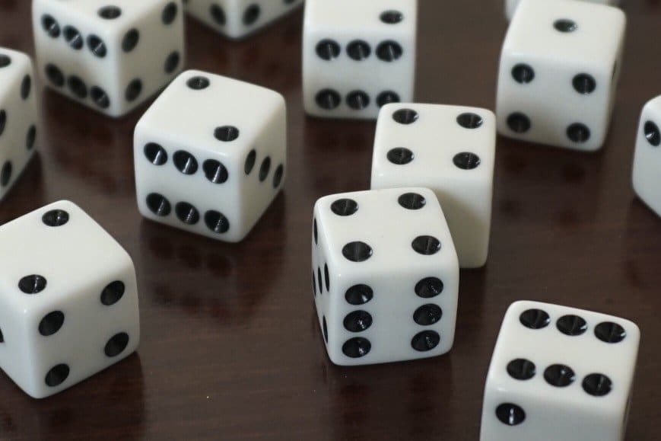
ACTIVITY – 2 (Dice Game)
On three / four dices, different operational symbols and different numbers will be pasted. Group wise the students will roll the dice and write down the expression obtained. Then they will solve the problem by Simplification.

Slide 17
* Solve the following.
(30 X 16 ) – 10 ( First multiply 30 by 16)
= 480 -10 ( Then subtract)
= 470
(9/3) + 6 X 2 ( First divide)
= 3 + (6 X2) (Then multiply)
= 3 + 12 (Lastly add)
= 15

Slide 18
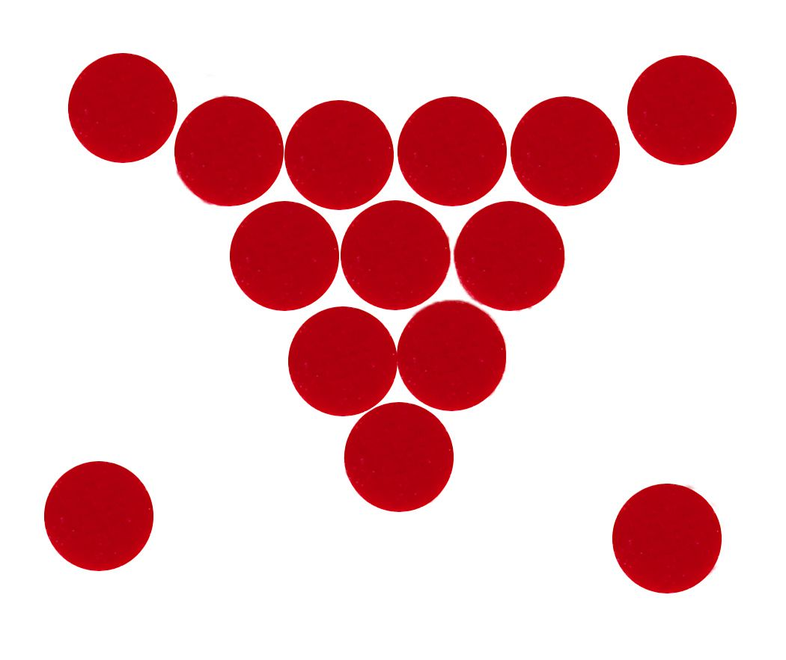
ACTIVITY – 3 (Bindi Game)
Instead of writing the numbers, the students will paste respective numbers of bindis on the paper. It will make the process of simplification more interesting.

Slide 19
SIMPLIFICATION INVOLVING FRACTIONAL NUMBERS :-
Fractional Numbers - The fractional numbers are two whole numbers (the fraction terms) that are separated by a horizontal line (the fraction line). The number above the line (the numerator) can be every whole number and the number below the line (the denominator) should be different from zero.
Some examples :- ¾ , 9/2 , 15/17
The simplification of fractional number involve the same BODMAS rule while simplifying the expression.

Slide 23
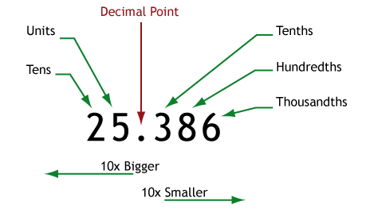
SIMPLIFICATION INVOLVING DECIMAL NUMBERS :-
Decimal Numbers - A decimal number can be defined as a number whose whole number part and the fractional part is separated by a decimal point. The dot in a decimal number is called a decimal point.
The simplification of Decimal number involve the same BODMAS rule while simplifying the expression.

Slide 27
KEYPOINTS
A mathematical expression in which two or more operations occur together is called a Numerical Expression.
In order to solve a numerical expression, we follow the Simplification Rule.

Slide 28
MIND MAPPING OF BODMAS
BRACKET
OF
DIVISION
MULTIPLICATION
ADDITION
SUBTRACTION

Slide 29
EVALUATE :-
Simplify the following expressions.
25 ÷ 5 X 8 + 6 – 12
17 X 3 + 81 ÷ 9 – 60
18 – 2 X 10 ÷ 2 + 2
7/8 - 3/8 ÷ 3/5
2/5 X 5/6 ÷ 2/3+ 5/12
1.1 + 2.5 – 1.5
5.3 + 6 X 0.05 – 2.1
2.3 + 1.2 X 0.5 – 0.9

